Slide 1
kHypervisor
Kelvin Chan
Game Security Researcher
Tencent

Slide 2
Who am I?
Kelvin Chan
Game Security Researcher, Tencent
Windows Kernel and low level stuff enthusiast
Game Security enthusiast
Twitter: @kelvin1272011
Email: kelvinchan@tencent.com / kelvin1272011@gmail.com

Slide 3
Agenda
Project Motivation
Common Hypervisor
Nested Virtualization Internals
Future

Slide 4
Motivation
Key objective is learning
Providing a detailed and properly documented project
Minimalist and straightforward code based
Focusing on Intel VT-x virtualization
Building a comprehensive hypervisor debugging framework
Portable, Modifiable, Simple

Slide 5



Common Hypervisor
Common hypervisors are too complex for beginners
Nested virtualization is unsupported
VirtualBox
Heavy weight, hard to understand.
KVM, BOCHS
Closed-Source
VMWare (WorkStation, ESX), Microsoft Hyper-V

Slide 6
Hypervisor Lifecycle
VMXON
VMXOFF
VMCLEAR
VMLAUNCH/
VMRESUME
VMPTRLD/
VMPTRST
VMREAD/VMWRITE

Slide 7
How does it work?
Overview
Virtualization
VM instructions
VMExit
VMEntry
VMCS
EPT
Goals
Use cases

Slide 8
Overview
Extending the work of HyperPlatform, a simple VT-x framework by Satoshi Tanda.
https://github.com/tandasat/HyperPlatform
Simple
The Nested Virtualization part is implemented in less than 3500 line of commented code.

Slide 9
virtualized instructions
VmxVmxonvirtualize
VmxVmxoffvirtualize
VmxVmclearvirtualize
VmxVmptrldvirtualize
VmxVmreadvirtualize
VmxVmwritevirtualize
VmxVmlaunchvirtualize
VmxVmresumevirtualize
VmxVmptrstvirtualize
VmxVMExitvirtualize

Slide 10
Hypervisor Lifecycle
VMXON
VMXOFF
VMCLEAR
VMLAUNCH / VMRESUME
VMPTRLD/
VMPTRST
VMREAD/VMWRITE

Slide 11
VMXON / VMXOFF
Trap these instructions and do following work:
Some regular parameter check
Initialize the Virtual CPU context and set the VMX mode
Save the current virtual machine control structure (VMCS)
VMCS0-1
L0 context for L1 use
Guest VMM
kHypervisor
Hardware

Slide 12
Hypervisor Lifecycle
VMXON
VMXOFF
VMCLEAR
VMLAUNCH / VMRESUME
VMPTRLD/ VMPTRST
VMREAD/VMWRITE

Slide 13
VMCLEAR
Clear the VMCS with the original VMCLEAR instruction
Ensure that VMCS0-2 can be loaded into CPU
Is executed before launching the Guest OS.
Guest VMM
kHypervisor
Hardware

Slide 14
Hypervisor Lifecycle
VMXON
VMXOFF
VMCLEAR
VMLAUNCH / VMRESUME
VMPTRLD/ VMPTRST
VMREAD/VMWRITE

Slide 15
VMPTRLD/ VMPTRST
VMPTRLD/VMPTRST instructions are responsible for loading the VMCS into the CPU
kHypervisor saves the VMCS (VMCS1-2) from the input parameter to the current CPU
kHypervisor create the new VMCS (VMCS0-2) for the current virtual CPU
Results in two distinct VMCS:
VMCS1-2 and VMCS0-2
Guest VMM
kHypervisor
Hardware

Slide 16
Hypervisor Lifecycle
VMXON
VMXOFF
VMCLEAR
VMLAUNCH / VMRESUME
VMPTRLD/ VMPTRST
VMREAD/VMWRITE

Slide 17
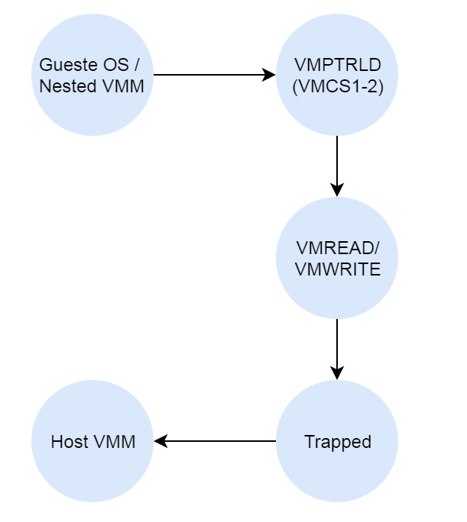
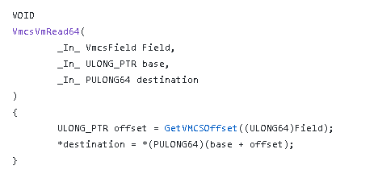
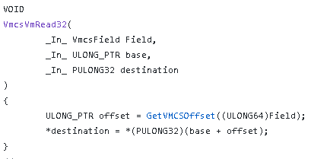
VMWRITE / VMREAD
- Guest VM is not aware that it is being virtualized
- After VMPTRLD execution, the Guest try to read/write its VMCS 1-2
- Trap the R/W instructions to intercept such events
- Direct R/W on the VMCS 1-2 memory space
- The memory layout VMCS 1-2 can be customized by kHypervisor
- Decode the parameter of R/W functions
- Use simple hash function and find the offset and perform R/W

Slide 18
Hypervisor Lifecycle
VMXON
VMXOFF
VMCLEAR
VMLAUNCH / VMRESUME
VMPTRLD/ VMPTRST
VMREAD/VMWRITE

Slide 19
VMLAUNCH/ VMRESUME
Launch the OS and VMM in the virtualized environment:
Argument check
Merging VMCS
VMEntry virtualization
Guest OS
Guest VMM
kHypervisor
Hardware

Slide 20
Expected Results
L2 to be successfully launched and to work normally
Events from L2 to be trapped as much as possible
Everything to be under L0 control
Guest VMM(L1) will be trapped by VMCS0-1
Guest OS(L2) will be trapped by VMCS0-2
L2 execute
L1 handle / dispatch to OS
L0 handle / dispatch to L1

Slide 21
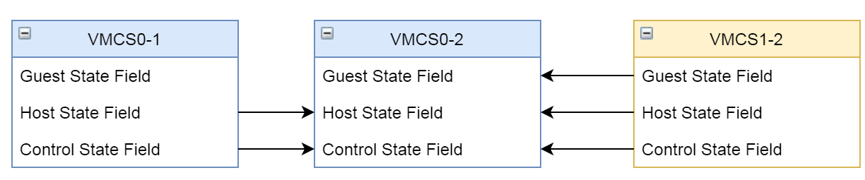
VMentry virtualization
Level 1 Guest VMM will execute VMEntry with the assistance of Level 0 Hypervisor
Core Concept
Leveraging VMLAUNCH / VMRESUME to switch back to guest mode of physical CPU, and control the execution path
- Implementation
Control the flow by VMCS, this provide different destination for the guest (included Guest VMM and OS)
VMCS0-2 Layout
VMCS0-2 Control State contains both VMCS0-1 and VMCS1-2 control states.
VMCS0-2 includes everything L1 and L0 requires.
VMCS0-2 Host State contains both VMCS0-1 and VMCS1-2 host states
They are used to ensure L2 can be correctly trapped
VMCS0-2 Guest Field is used for launch L2 whatever L1 wants to create

Slide 22
Merging VMCS
VMCS0-1 from Level 0 to launch Level 1
VMCS1-2 from Level 1 to Level 2. This won’t be loaded but is required by the guest
L1 always think it is being used
VMCS0-2 from Level 0 to Launch level 2
L1 execute VMPTRLD with VMCS1-2
L0 save the VMCS1-2 pointer
L1 execute VMRW with VMCS-12
L0 perform the VMRW on the VMCS1-2
L1 execute VMLAUNCH/VMRESUME
L0 prepare VMCS0-2 by extracting VMCS12 and VMCS0-1
L1 Launch L2
L0 virtualizes VM Entry to L2
(Physical CPU going to the Guest VMX Mode)
Get the new l2 state from vmcs02

Slide 23
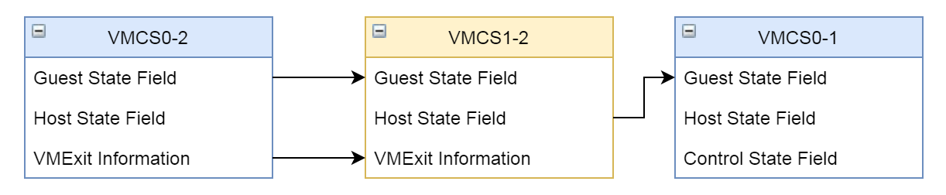
VMExit virtualization
Core Concept
Leverage VMRESUME to perform VMEXIT virtualization
Implementation
Control the flow by VMCS, this provide different destinations for the guest (included Guest VMM and OS)
Fake “VMExit” but L0 hands off the control to L1 along with the VMX mode change (Guest Mode)
The fake “VMExit” will trigger the L1 VMM trap again, even though L1 think it is already root mode.
Finalizing the fake VMExit by trapping into L0 again (VMRESUME)
VMCS01 Layout
Saved copy of the VMCS0-2 Guest State into VMCS1-2
Saved copy of the VMCS0-2’s exception related context into VMCS1-2
Loading the L1 VMExit handler in VMCS0-1 Guest Rip field along with its stack, rlfags, etc.

Slide 24
VMExit virtualization
The processor control flow turn to L1 VMExithandler.
L1 tries to read / write the information from/to VMCS1-2 which triggers VMExit from L1 again
VMResume to L1
L0 perform VMEntry virtualization
Control flow to L1 VMExit Handler
L1 execute VMResume
L1 modify VMCS by VMREAD VMWRITE and get trapped

Slide 25
EPT virtualization
EPT translates Guest Physical Address (GPA) to Host Physical Address (HPA)
Processors only accept 2-level address translation
Guest EPT are monitored by Level 0
Use Monitor Trap Flag (MTF) for trapping any modification
EPT0-2 = EPT1-2 + EPT0-1, give it to the processor which performs the translation for us
GVA
Guest CR3
L2 GPA
v
L2 GPA
EPT1-2
v
L1 GPA
EPT0-2
EPT0-1
HPA
HPA

Slide 26
EPT virtualization
L1 VMM
The page entry of EPT1-2 in EPT0-1 is always mark as read-only
Any access to EPT1-2 from L1 will causes EPT violation
Set Monitor Trap Flag (MTF) to follow up with those special cases
EPT0-2 can be updated by accessing EPT1-2 after a write
Reset the page attributes and reload the EPT0-2
Update
EPT1-2
GVA
01
EPT
read-only
area
Guest CR3
L2 GPA
L2 GPA
EPT1-2
EPT0-2
L1 GPA
HPA
EPT0-1
HPA

Slide 27
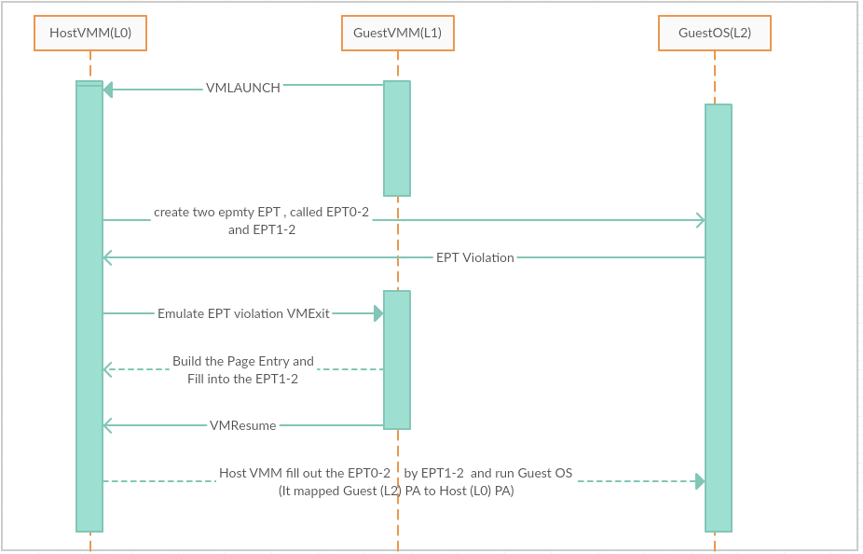
EPT virtualization
EPT-on-EPT, build entry on-the-fly

Slide 28
EPT virtualization
EPT-on-EPT, build entry on-the-fly

Slide 29
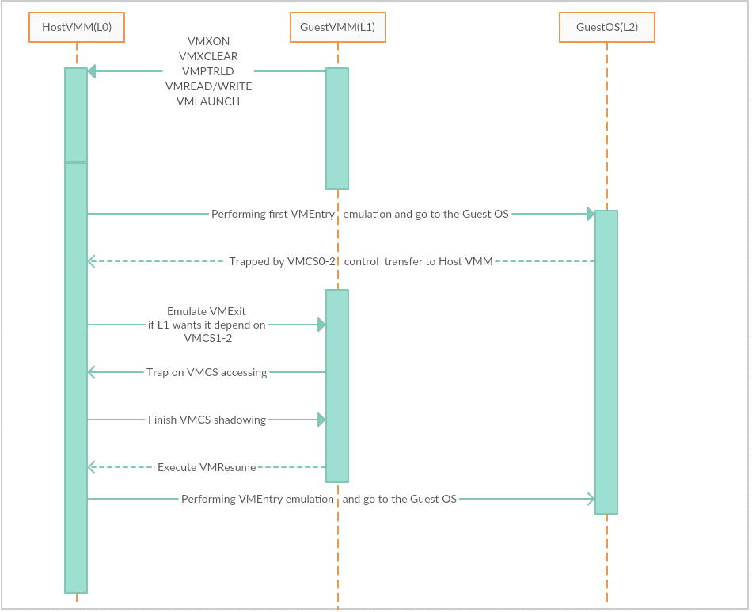
Full Picture - Review

Slide 30
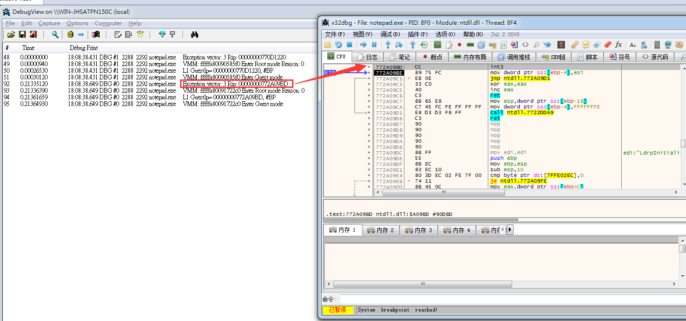
Use Case
Analysis of hypervisor-based rootkits
The hypervisor offers an easy way to trigger exceptions / interrupts
kHypervisor offers the ability to monitor the redirection of exceptions and interrupts
We are transparent
Rootkits are still functioning as expected.

Slide 31
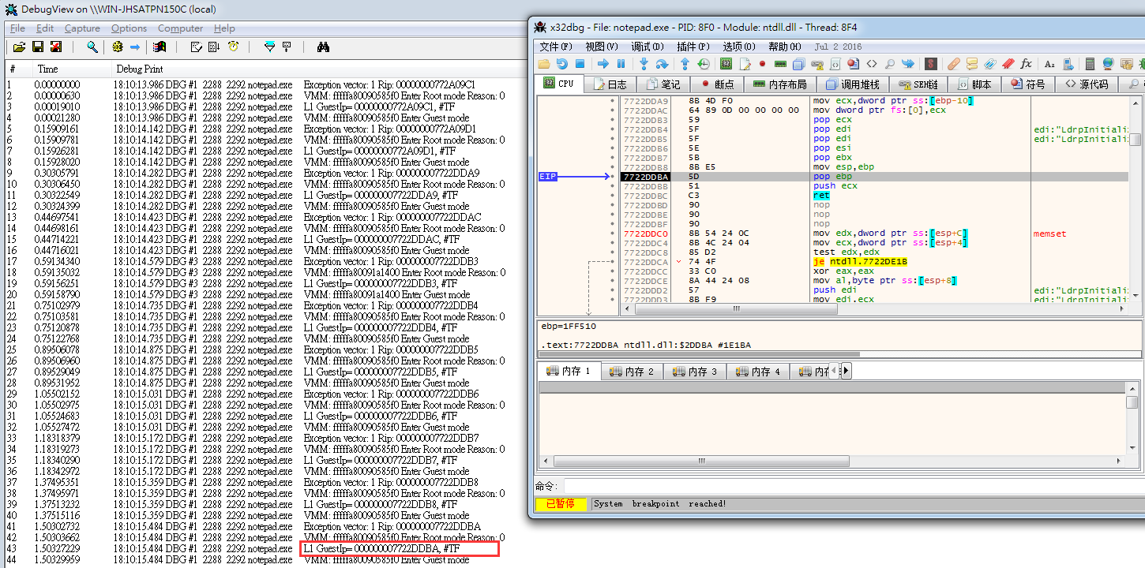
Use Case
Monitoring the single stepping exceptions along with hypervisor-based rootkit.
Monitoring shadow walker

Slide 32
Nested debugging
Larger scope of debugging!
Nested Virtualization Debugging
Host VMM can take over all of the exceptions and interrupts.
VirtIce provided the following functions:
VMExit / VMEntry breakpoint and tracing
Put the Hyper-malware sample into the debugger
To be continued…

Slide 33
More
Provide VMExit tracing features
Enabling on-the-fly Hypervisor debugging
Malware Analysis

Slide 34
Resources
Github
https://github.com/Kelvinhack/kHypervisor
How does Nested Virtualization Works? (February 2018)
https://kelvinhack127.blogspot.com/2018/02/how-does-nested-virtualization-works.html

Slide 35
Further Research
APIC virtualization
Windows Debugging features
Nested Hypervisor debugging

Slide 36
Conclusion
Nested Virtualization Debugging is important for the security researchers especially because of the rise of hypervisor-based malwares and rootkits.
Those are impossible to debug with traditional debugging, but Nested Virtualization Debugging is a solution to that problem.

Slide 37
Thanks
My teammates
Satoshi Tanda @standa_t
Author of HyperPlatform

